Slide 1
Capstone Project -
The Battle of Neighborhoods

Slide 2
Study done for:
The current study is done for new Indian immigrants to Canada.
In a hypothetical case, Indian immigrant wanting to settle in a place that has Indian restaurants and Swimming pool for his daily swim for recreation and health.

Slide 3
Data acquisition
Three datasets are used for the study. Data scrapping from Wikipedia to obtain the neighbourhood and obtaining required information from blogto.com, then the Foursquare API to enable the location data required for the study are employed.
https://en.wikipedia.org/wiki/List_of_postal_codes_of_Canada:_M
https://www.blogto.com/neighbourhoods/
https://foursquare.com/

Slide 4
Data Cleaning
· The data frame will consist of three columns: Postal Code, Borough, and Neighborhood
Only process the cells that have an assigned borough. Ignore cells with a borough that is ‘Not assigned’

Slide 5
Data organizing
Collapsing the data to make a new data frame having one neighborhood.
df_merge.rename(columns={'Neighborhood_joined':'Neighborhood'},inplace=True)

Slide 6
Obtaining data from foursquare
· · The foursquare data is used to data frame out the venues in the chosen neighbourhood.
CLIENT_ID = 'QEF4SFROUUVOQKNPAFNNRDUW4ACAWSYYG312LM3BKEDDKPIZ' # Foursquare ID
CLIENT_SECRET = 'CCBFW1WDVTUYDLPFX3SR0QBB5R2UKRYOZ3F1JDJ3PLQMPDRM' # Foursquare Secret code
VERSION = '20201004’

Slide 7
Adding latitudes and longitudes and filtering out the required data
· Adding latitude and longitude coordinates to the above data frame gives a scope to visualize the data frame if need be.
from geopy.geocoders import Nominatim
def get_geocode(postal_code):

Slide 8
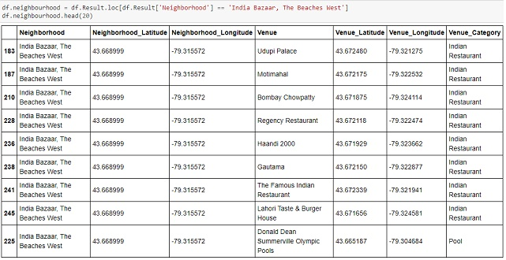
Final data structure depiction

Slide 9
Conclusion
The Beaches West has 8 Indian restaurants and 1 pool and thus we can conclude the neighbourhood " India Bazaar, The Beaches West " is the ideal place for our new immigrant to settle in……….

